Slide 1


PEAT
GUARD
BUILT BY: YARA MATOUK & SANDRINE MADELEINE
PREDICTING PEAT FIRES BEFORE THE HAZE
TEAM WIZARDS | DORMATHON 2026 | TRACK 1: PREDICTIVE MODEL

Slide 2
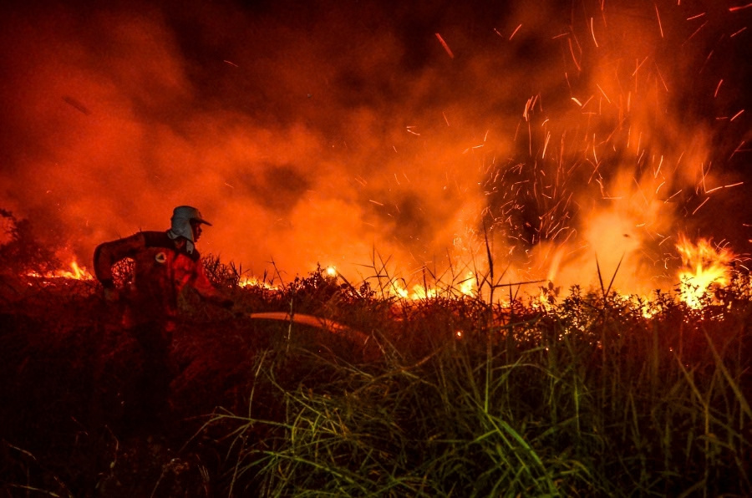
THE PROBLEM
THE THREAT BURNS BENEATH OUR FEET:
SPOT THE DANGER BEFORE IT SPARKS.
PEAT FIRES BURN UNDERGROUND, SPREAD UNSEEN, AND ARE EXTREMELY HARD TO PUT OUT ONCE THEY START.
THE 2015 HAZE CRISIS BURNED ABOUT 2.6 MILLION HECTARES AND COST INDONESIA AN ESTIMATED US$16 BILLION (WORLD BANK).
HAZE CLOSES SCHOOLS, GROUNDS FLIGHTS, AND SENDS RESPIRATORY CASES UP ACROSS MALAYSIA, INDONESIA, AND SINGAPORE.

Slide 3
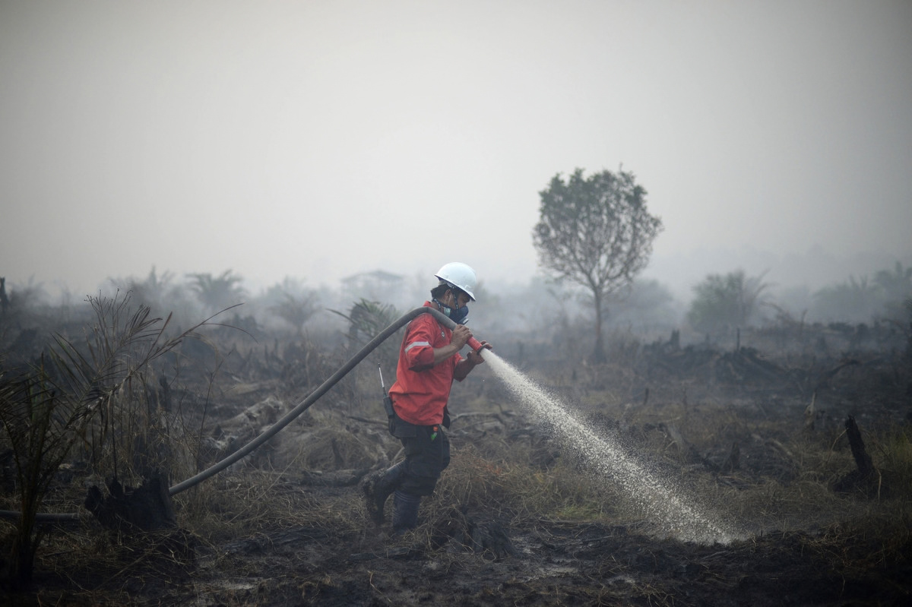
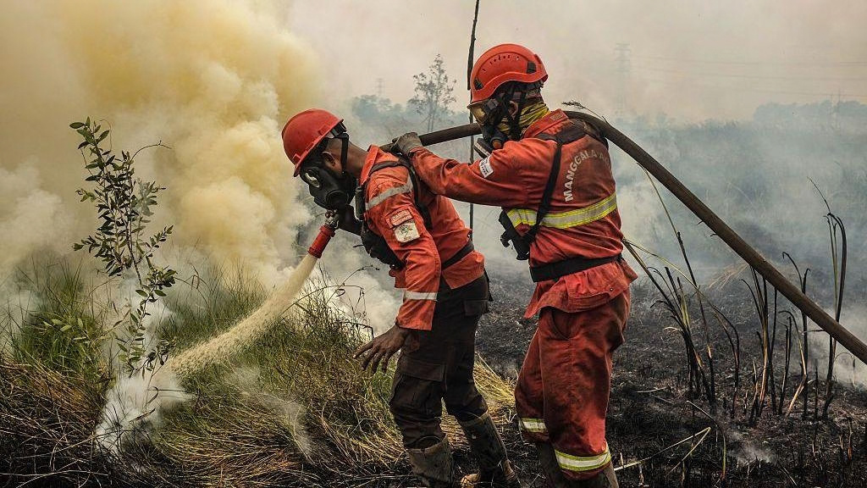
THE GAP
WE REACT. WE DON’T PREDICT.
AGENCIES AND COMMUNITIES GET HOURS OF WARNING, NOT DAYS.
EXISTING FIRE DANGER RATINGS ARE WEATHER-BASED AND COARSE, NOT SPECIFIC TO PEAT CONDITIONS.
TODAY’S TOOLS ARE REACTIVE: SATELLITE HOTSPOTS AND API READINGS REPORT FIRES AND HAZE AFTER THEY BEGIN.

Slide 4
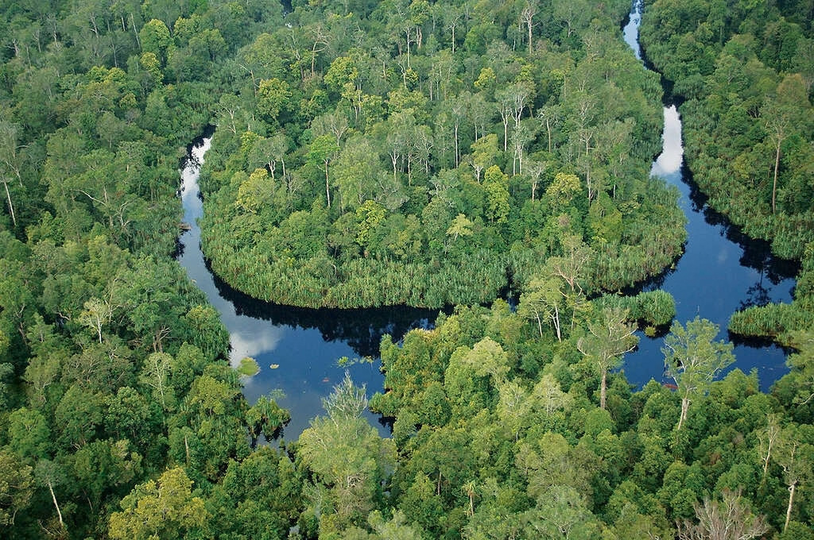
THE SOLUTION
FIRE RISK FOR THE NEXT 7 DAYS, FOR 71 PEATLAND AREAS
FLAGS WHEN TODAY’S WIND WOULD CARRY SMOKE TOWARDS MALAYSIA
EARLY ALERTS SO RESPONDERS CAN RE-WET PEAT, PATROL, AND WARN THE PUBLIC BEFORE IGNITION.
PREDICT THE FIRE BEFORE IT STARTS

Slide 5
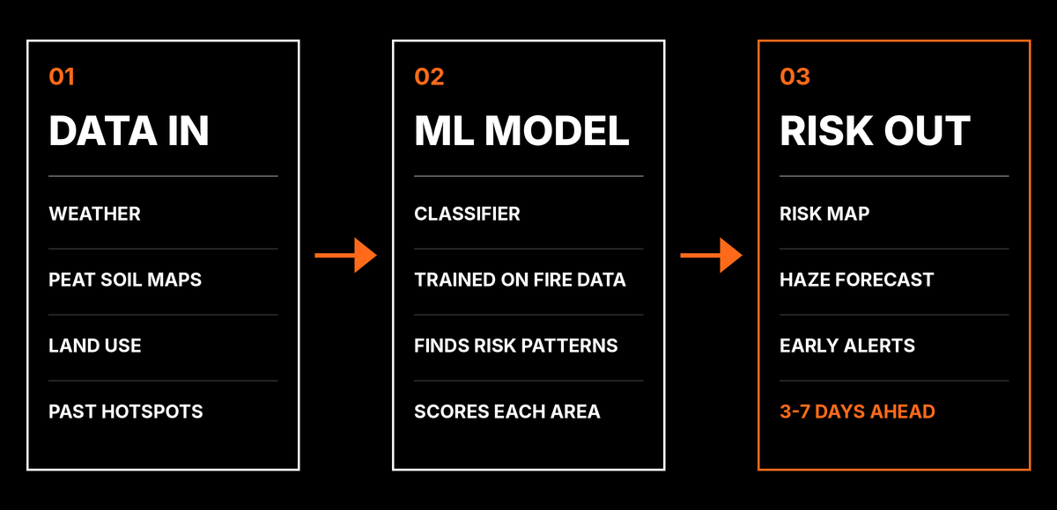
HOW IT WORKS
FROM RAW DATA TO EARLY WARNING.
INPUTS: RAINFALL, TEMPERATURE, HUMIDITY, WIND, DAYS SINCE RAIN, PEAT SOIL MAPS, LAND USE, AND HISTORICAL HOTSPOTS.
MODEL: A MACHINE LEARNING CLASSIFIER (E.G. RAINFALL WINDOWS, DRY DAYS, ESTIMATED PEAT WATER TABLE, WEATHER VS NORMAL, EL NIÑO / IOD, FIRE HISTORY
OUTPUT: A RISK MAP, A HAZE DIRECTION FORECAST, AND ALERTS SENT TO RESPONDERS.

Slide 6

DATA SOURCES
NASA FIRMS VIIRS
NASA POWER WEATHER
OPEN-METEO FORECAST + AIR QUALITY (CAMS)
NOAA EL NIÑO / IOD

Slide 7
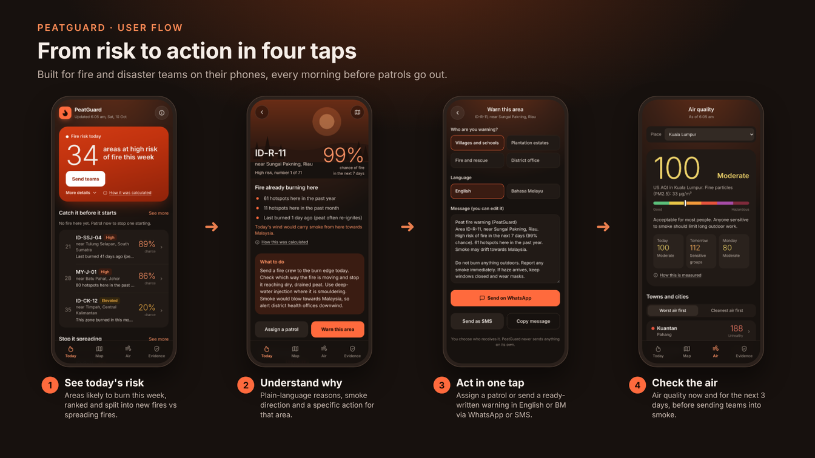
PROTOTYPE
SEE FOR YOURSELF, CLICK THE LINK BELOW

Slide 8
IMPACT
PREVENTION COSTS FAR LESS THAN FIREFIGHTING AND HEALTH CARE AFTER THE FACT.
PROTECTS PEATLANDS, WHICH HOLD ROUGHLY TWICE THE CARBON OF ALL THE WORLD’S FORESTS ON ABOUT 3% OF ITS LAND.
USERS: FIRE AND RESCUE DEPARTMENTS, ENVIRONMENT AGENCIES, PLANTATION OWNERS, AND LOCAL COMMUNITIES.

Slide 9
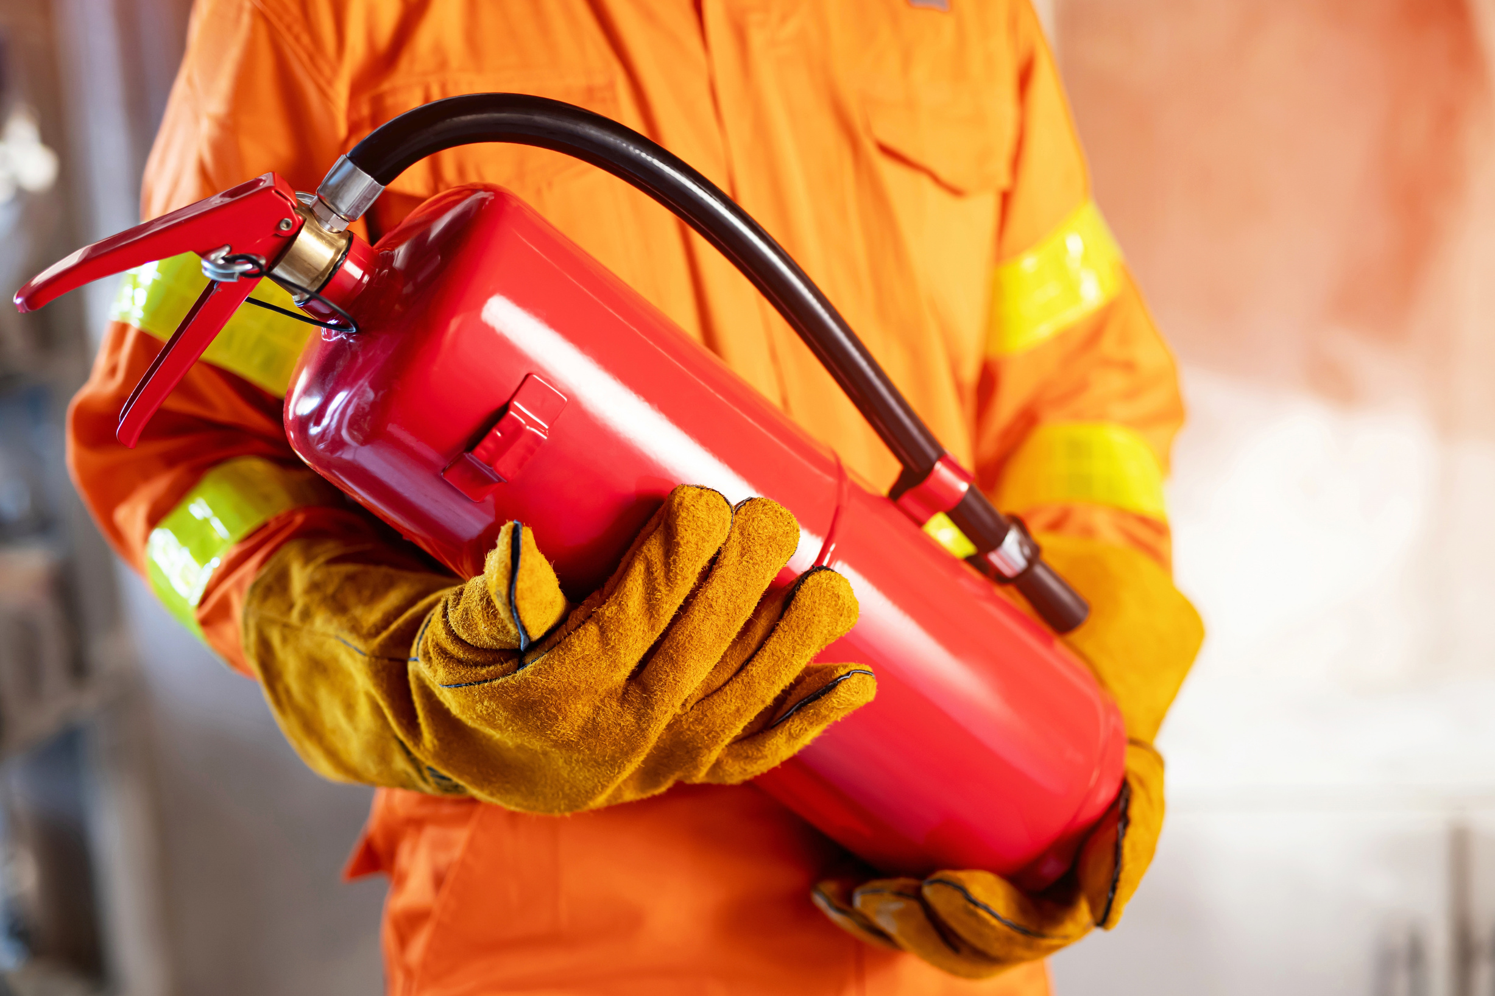
NEXT STEPS
ADD PEAT GROUNDWATER LEVEL AND SOIL MOISTURE SENSORS (IOT) FOR SHARPER PREDICTIONS.
PILOT IN ONE HIGH-RISK DISTRICT, E.G. IN SELANGOR OR SARAWAK.
EXTEND TO A PUBLIC MOBILE ALERT APP.

Slide 10
END OF PRESENTATION

